Slide 1

DriverPass System Analysis
Kennedy Uzoho

Slide 2

System Requirements
The system shall offer three different driving packages.
The system shall allow the user to book, modify, and cancel appointments.
The system shall provide online practice exams.
The system should be web based in the form of a website.
The system should be fast enough to allow the user to access the website without any complications.
Notes:
The system shall validate user credentials when logging in.
The system shall update all data and information between platforms.
The system shall allow a user to reset their password.
The system shall allow data to be modified on any platform.
The system shall tell the progress of scheduled training and hours taken.
The system shall be updated with any DMV regulations or laws.
The system shall show online test progress.
The system shall display user information.
The system shall be flexible and able to modify to add new features.
The system needs to run fast enough to quickly update its web browser and its corresponding applications.
The system should be updated after each modification and on a scheduled basis.
Modification:
New Security Update
Reports of Crash/Buggs
General Updates/Scheduled Updates
New DMV test regulations, new laws, and legal/illegal driving information

Slide 3
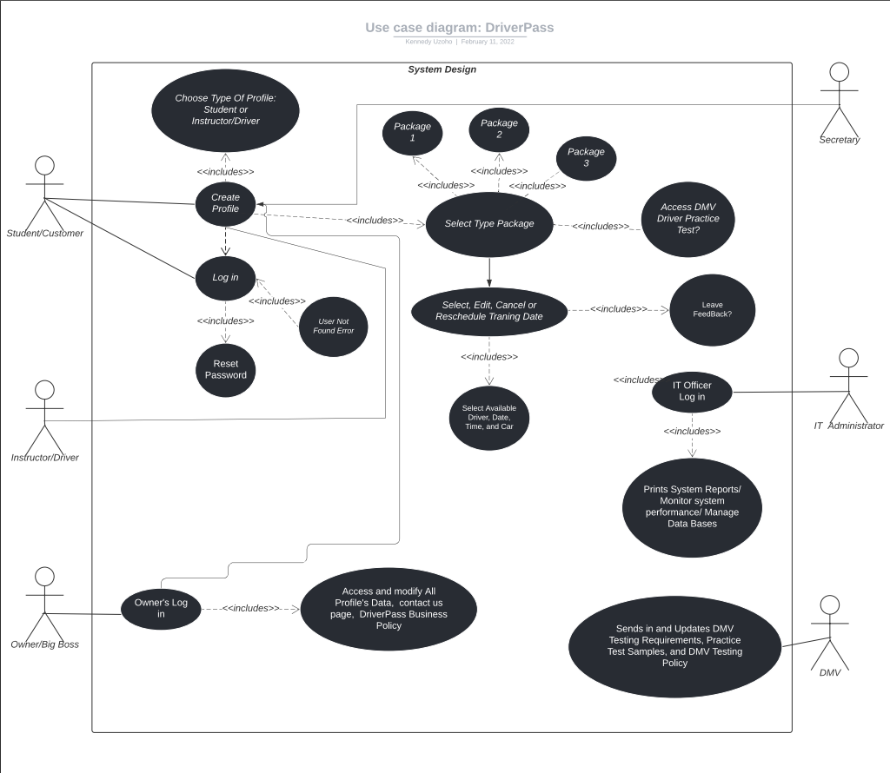
Use Case Diagram
Notes:
In this use case diagram, the different actors include customer/student, Instructor/driver, Owner/BigBoss, IT admin, and Secretory. The DMV could be a type add-on that automate and update DriverPass database with the most updated DMV rules and regulations.

Slide 4
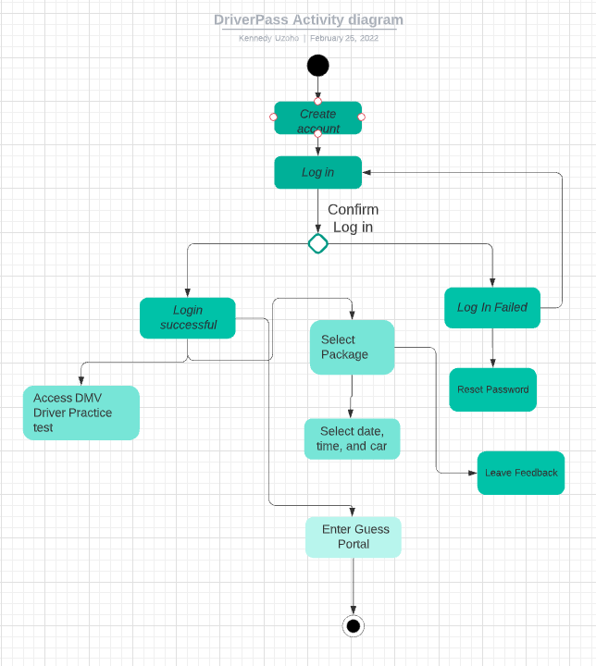
Activity Diagram
Notes:
In this diagram, the different actors include customer/student, Instructor/driver, Owner/BigBoss, IT admin, and Secretory. The DMV could be a type add on that automate and update DriverPass database with most updated dmv rules and regulations.
The Use Case for this activity diagram is mainly designed for the guest/customer and any available secretary that will register and schedule customer.

Slide 5
Security
The cloud/server will be responsible for the data exchange between the client and server.
The user will require a username and password to log in
Multi-factor authentication will be used when logging into the site.
Accounts will be disabled after three incorrect login attempts. This will help prevent brute force attacks
If user forgets their password, they will be able to reset their password through their email address.
Track user made changes
Notes:
The user will require a username and password to log in
Multi-factor authentication will be used when logging into the site.
Accounts will be disabled after three incorrect login attempts. This will help prevent brute force attacks
If user forgets their password, they will be able to reset their password through their email address.
Track user made changes

Slide 6
System Limitations
No budget given for project.
Only five months to build the system, forced to take an agile approach.
The system will not function without internet connection
Notes:
May not be able to operate offline to avoid duplication of data
We should be good on the budget unless a serious issue, flaw, disturbs the project.
Not so many technical limitations, however a web browser on a traditional computer usually has more processing power compared to mobile devices due to the CPU and memory allocation, so with this in mind, we need to optimize the mobile devices to function very well.

